Slide 1
AdventureWorks
Sales Performance Overview of 2003

Slide 2
Key Performance Indicators (2003 vs 2002) Total Sales Value Up by 36.19%, with Significant Growth in Orders Order Count increases by 237%, While Average Order Value Drops by 59.59% Gross Profit Growth, but profit margin is lower side: 12.6 %
54.31M
12.44K
4.36K
36.19%
237%
-59.59%
30.83%
Total Due 2003
Orders Count 2003
Average Order Value 2003
Gross Profit 2003

Slide 3
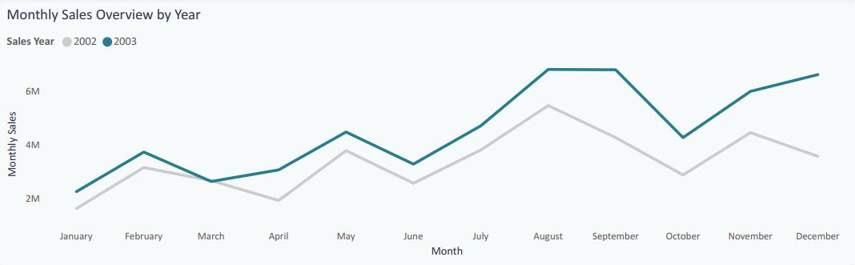
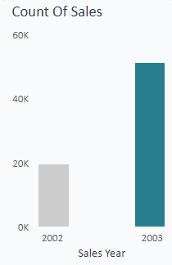
Steady Sales Growth with a Peak in Mid-2003 2003 Sales Volume Doubled Compared to 2002 Each Quarter Outperformed the Same Period in 2002
Period of Special Offers

Slide 4
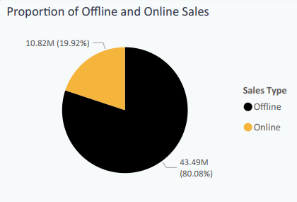
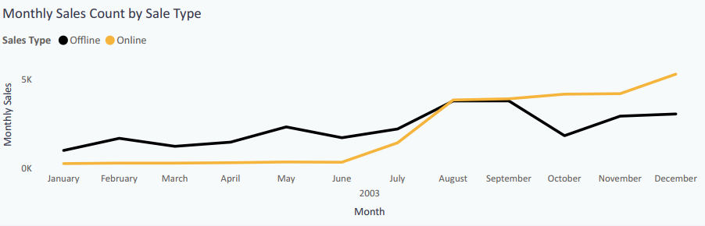
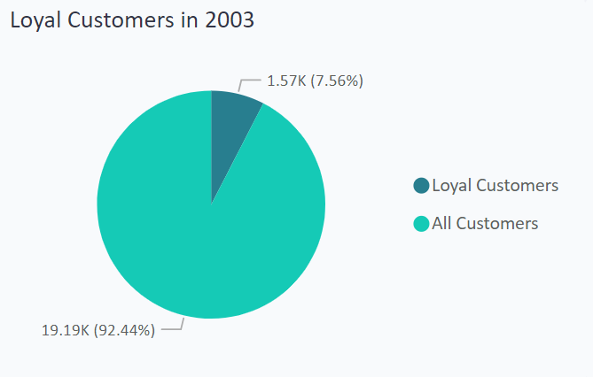
Online Sales Overtake, but Offline Holds 80% of 2003 Total Significant Online Increase Post-August, Yet Offline Sales Lead the Year Offline Sales Remain the Bulk Despite the Late-Year Online Surge
Period of Special Offers

Slide 5
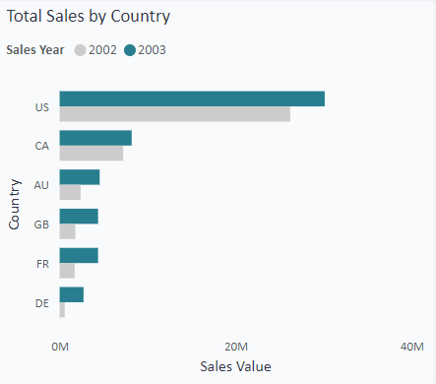
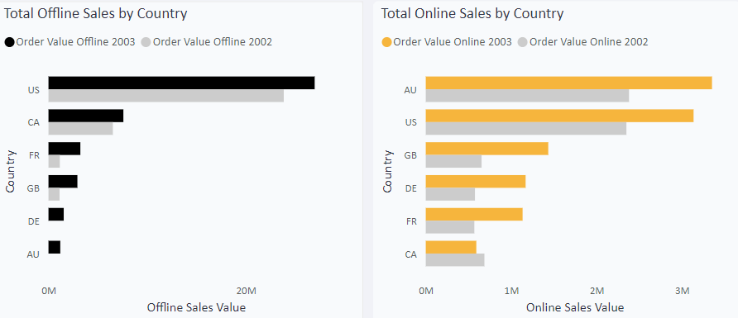
USA Leads Sales, But Australia Rises in Online Sales Offline Sales Mirror Overall Trend, with the USA Leading by a Wide Margin In 2003, Australia Emerges as the Online Sales Leader, Tied with the USA

Slide 6
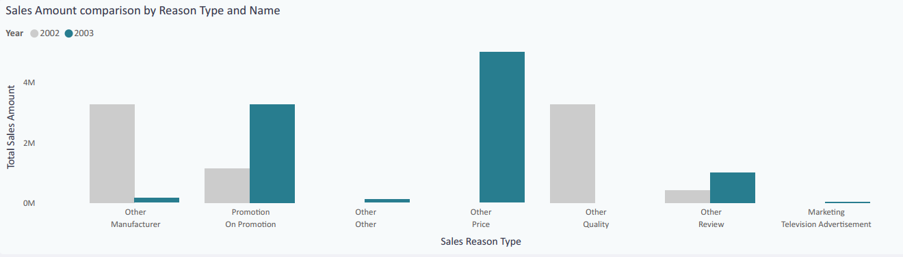
Consumer Shift: Price Sensitivity and Promotions in 2003 2002 Shoppers Valued Quality and Brand 2003 Shoppers Became More Price-Driven, Responding to Promotions

Slide 7
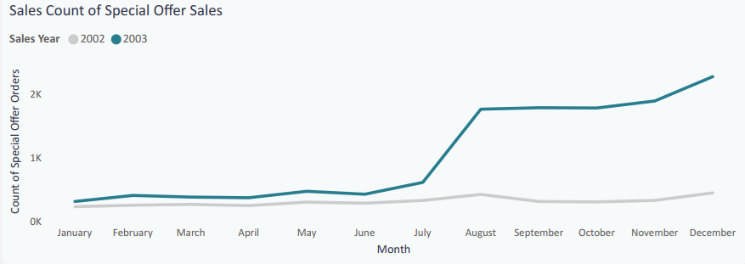
Special Offers: Key Driver of Sales Surge in 2003 Low Sales Until July, Followed by a Dramatic Rise in August By December, Special Offer Sales Count Hits 2,500, Far Surpassing 2002

Slide 8
Strategic Insights for Future Growth
Leveraging Promotions: Increasing Impact on Sales Performance
Enhancing Online Channels: Significant Growth Potential After 2003
Boosting Average Order Value: A Key Area for Improvement

Slide 9
Key Takeaways and Next Steps
Promotions and Online Sales Are Critical Growth Drivers
Focus on Aggressive Online Strategies and Pricing Adjustments Moving Forward
Tailor Marketing Strategies by Region

